Slide 1


GE19612- PROFESSIONAL READINESS
FOR INNOVATION EMPLOYABLILTY
AND ENTREPRENEURSHIP
Agriculture Management System
Project Guide
Dr.T.Kumaragurubaran.,
M.Tech.,Ph.D
AP(SG)
By
1)AAKIL SHIHAF V (210701004)
2)ABDULLA NADHEEM (210701008)

Slide 2
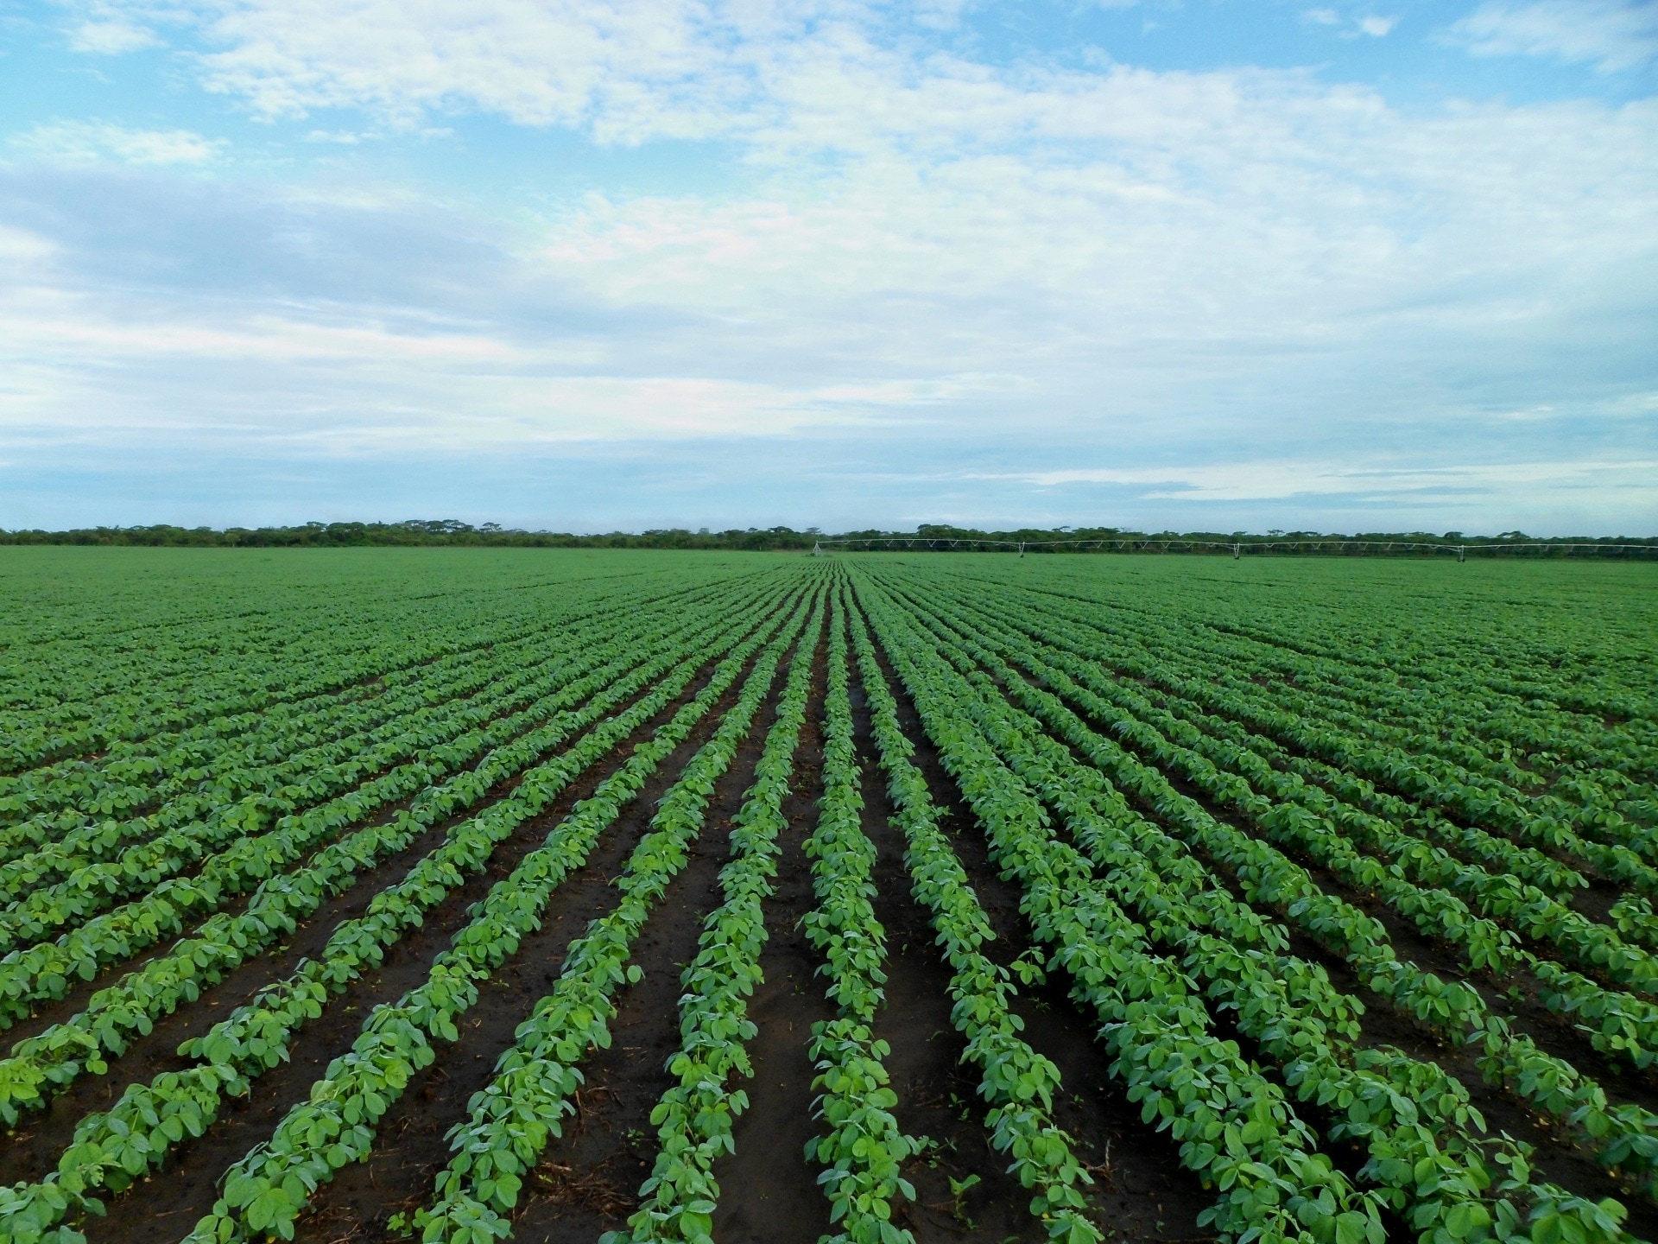
Abstract
The Agriculture Recommendation System (ARS) is a sophisticated tool designed to aid farmers and agricultural stakeholders in optimizing crop management practices and enhancing yield outcomes. By harnessing advanced data analytics and machine learning techniques, the ARS offers a suite of interconnected modules to provide predictive insights and personalized recommendations across various aspects of crop cultivation.

Slide 3
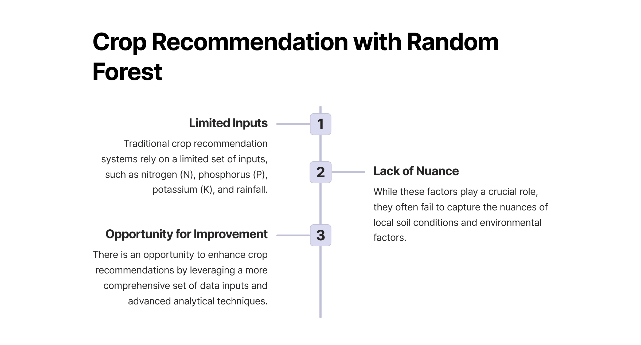

Slide 4
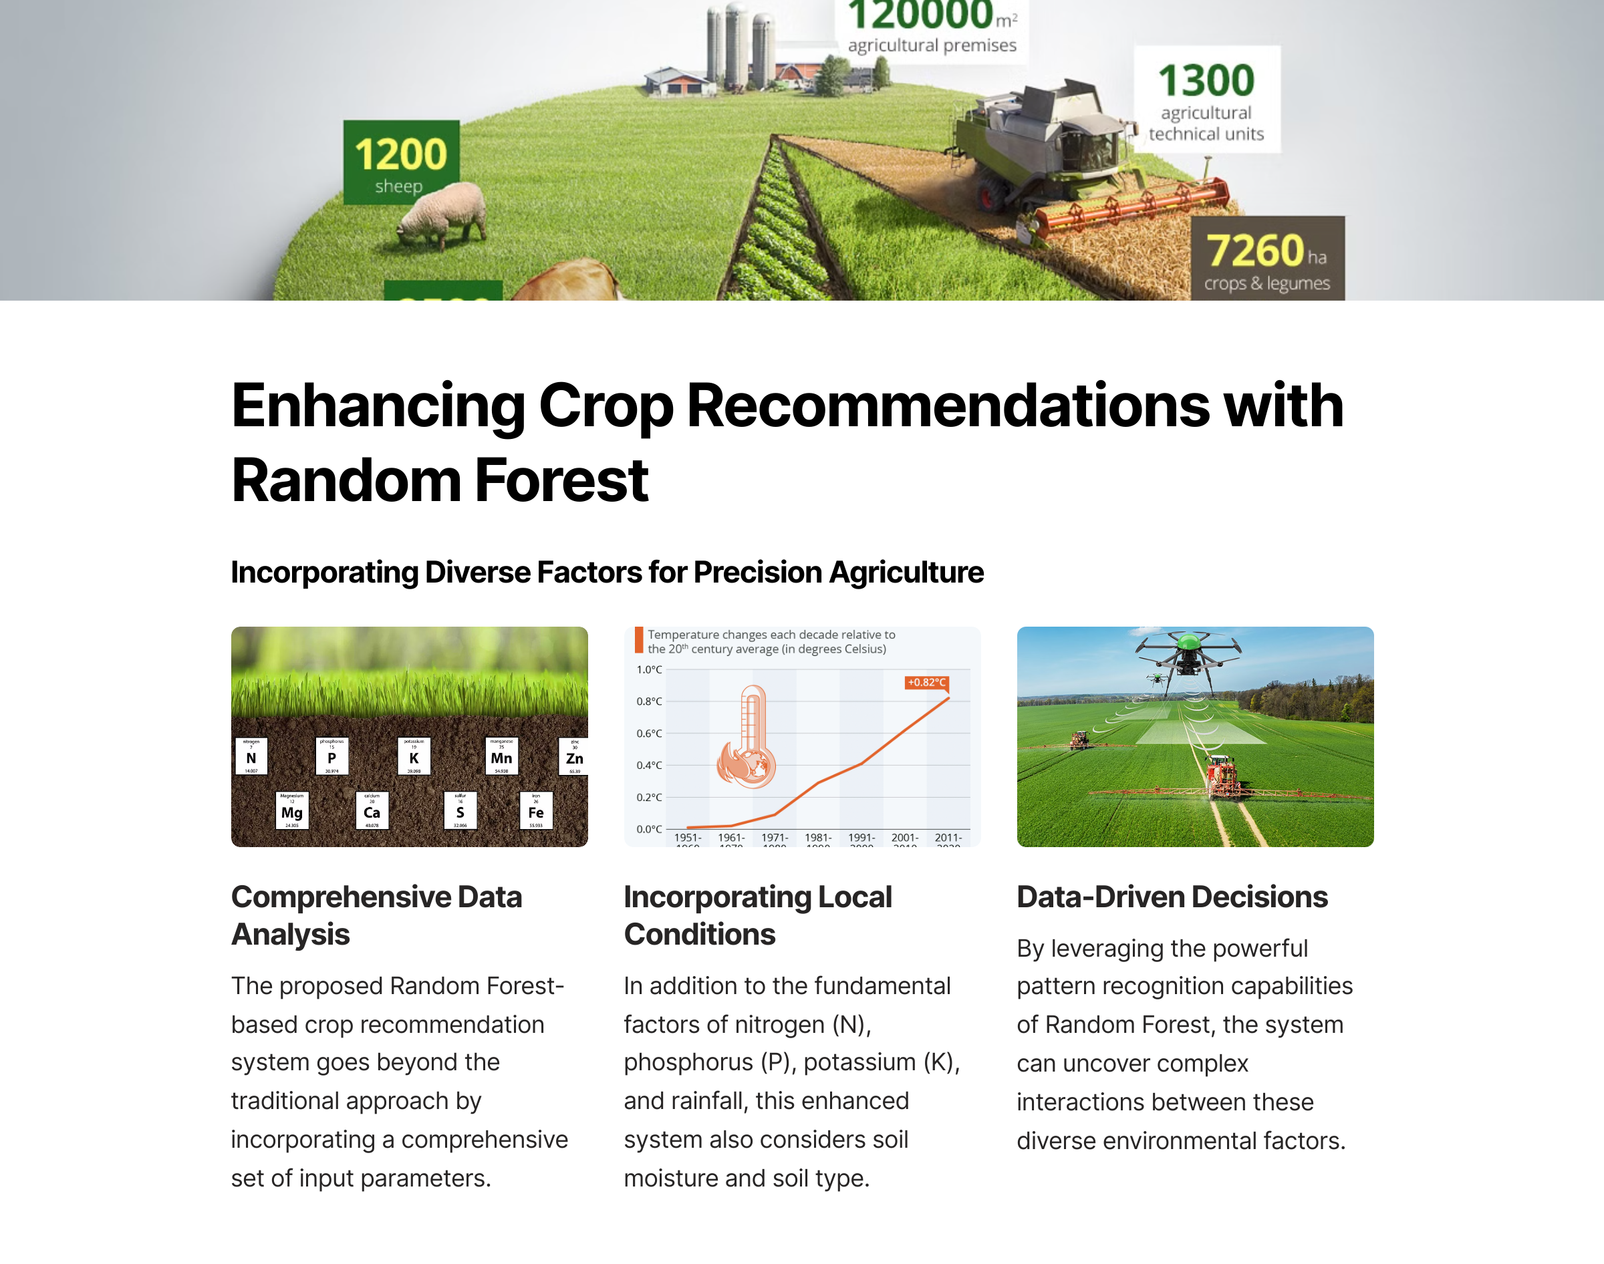

Slide 5

Random Forest Algorithm
1
Robust Predictive Modeling
2
Handling Complex Data
The Random Forest algorithm combines multiple decision trees to create a powerful predictive model for various agricultural applications.
It can effectively handle high-dimensional data, including both numerical and categorical variables, making it suitable for diverse agricultural scenarios.
3
Improved Accuracy
The ensemble approach of Random Forest increases the overall accuracy and stability of the predictions, crucial for informed decision-making.

Slide 6
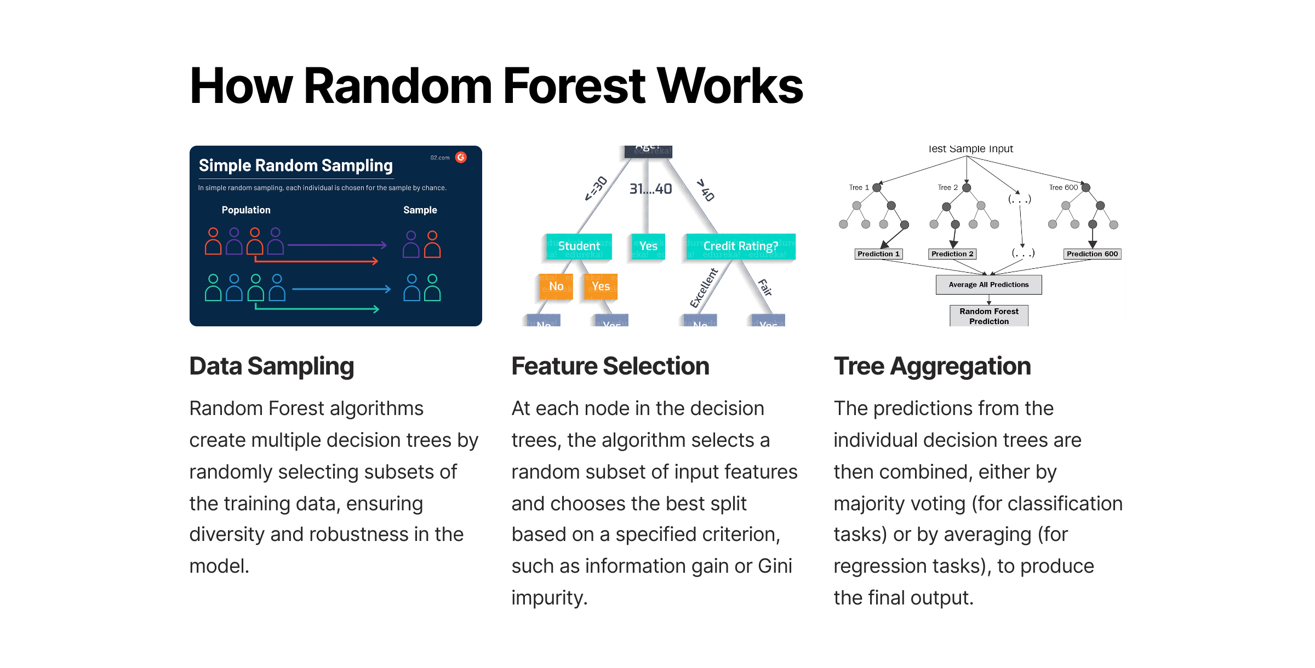

Slide 7
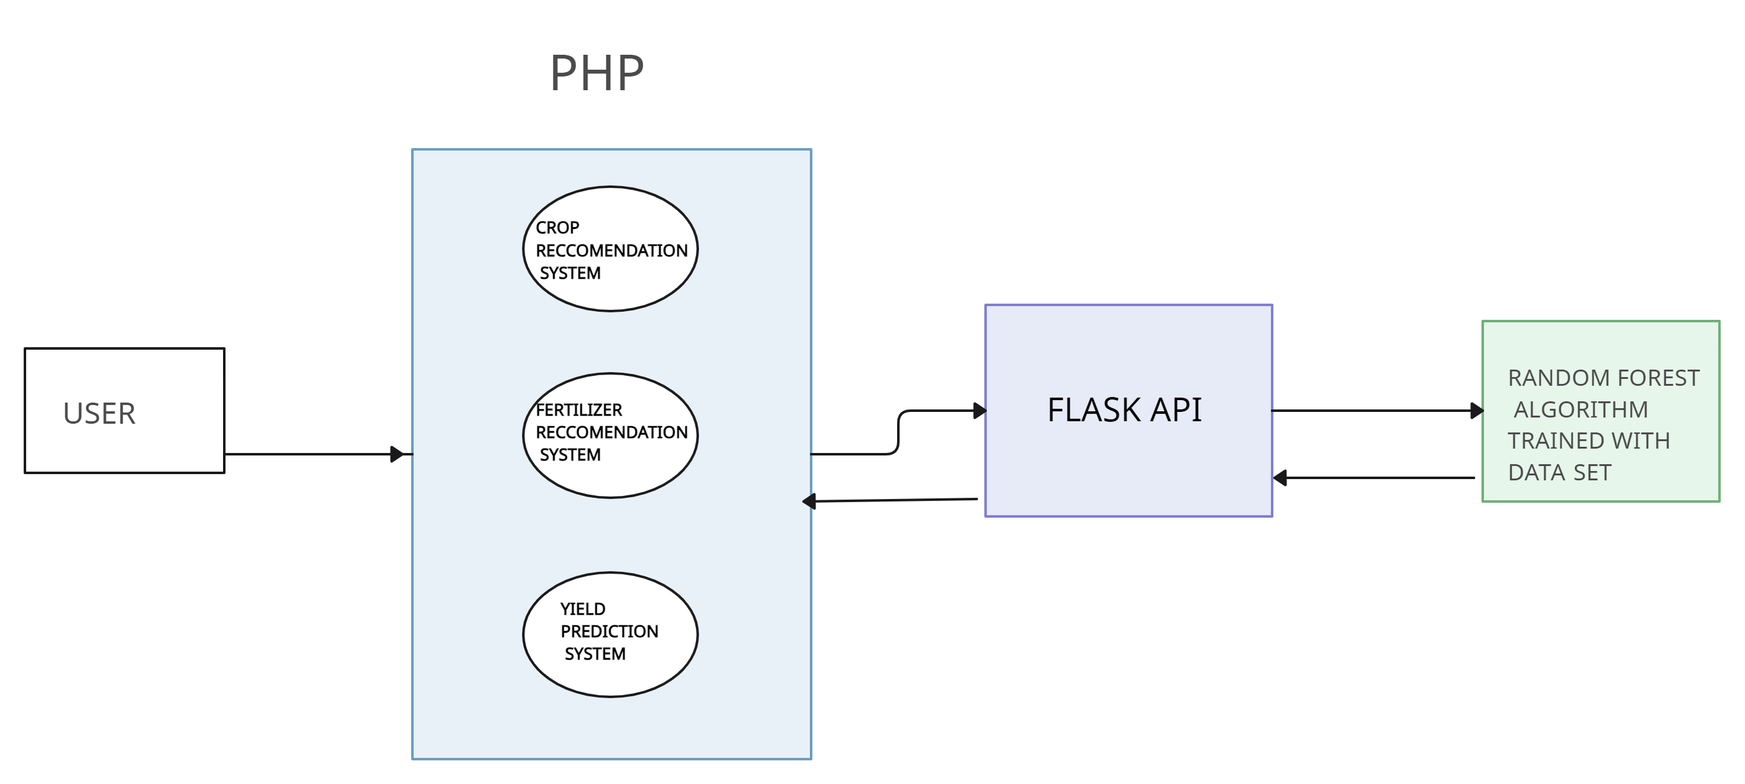
SYSTEM ARCHITECTURE:

Slide 8
Crop Recommendation
Soil Analysis
Climate Factors
Market Demand
Our system analyzes the soil composition, pH, and nutrient levels to recommend the most suitable crops for optimal growth and yield.
It considers historical weather data, rainfall patterns, and temperature ranges to suggest crops that thrive in the local environment.
The system also factors in market trends and demand to provide recommendations that align with profitable crop choices.

Slide 9
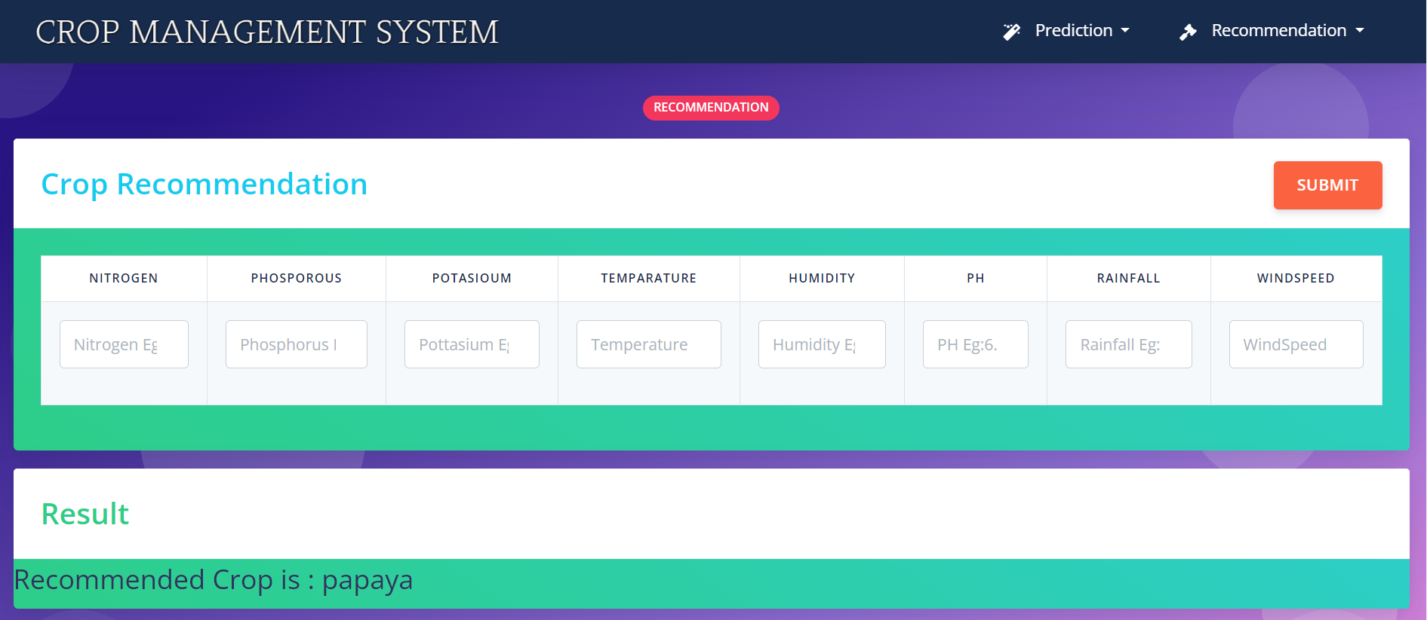
OUTPUT

Slide 10

Fertilizer Recommendation
Soil Testing
Application Guidance
Our system conducts comprehensive soil testing to determine the exact nutrient requirements of the crops.
The system provides detailed instructions on the right fertilizer application methods and timing for maximum effectiveness.
1
2
3
Nutrient Balancing
It then recommends the optimal fertilizer blend to replenish the soil's nutrients, ensuring healthy plant growth.

Slide 11
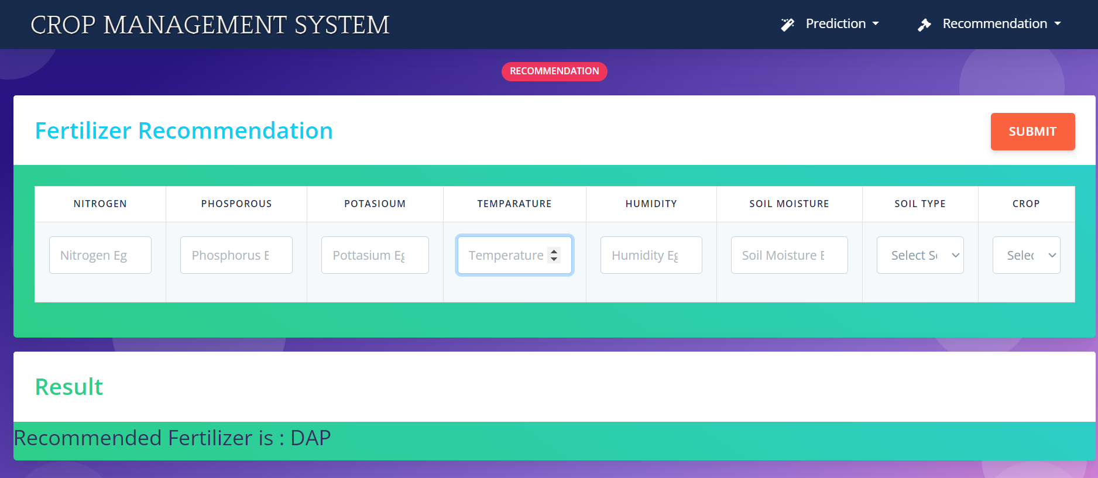
OUTPUT

Slide 12
Rainfall Prediction
Machine Learning Models
Real-Time Monitoring
Our system employs advanced machine learning algorithms to analyze historical weather data and predict future rainfall patterns.
It integrates with weather sensors and satellite imagery to provide real-time updates on precipitation levels and trends.
Actionable Insights
Early Warning System
The rainfall predictions help farmers plan their irrigation schedules, planting timelines, and other critical agricultural activities.
The system can also alert farmers to potential droughts or excessive rainfall, enabling proactive risk mitigation strategies.

Slide 13
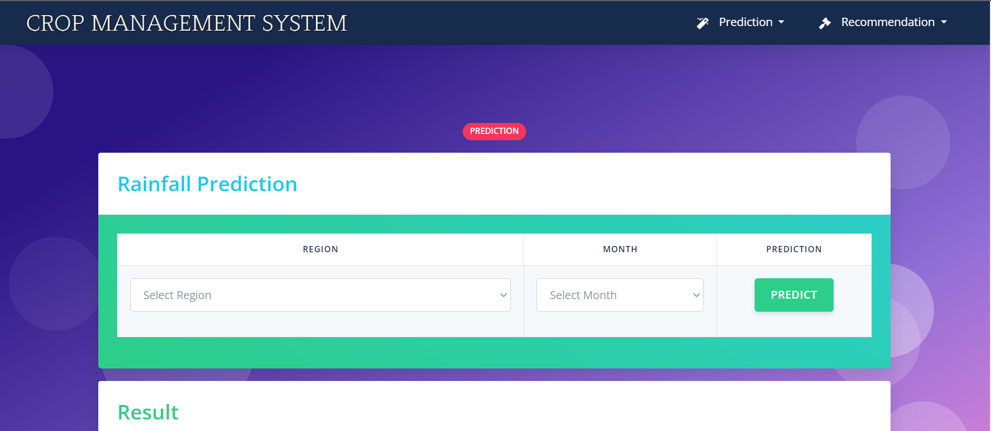
OUTPUT

Slide 14



Yield Prediction
Crop Monitoring
Predictive Modeling
Adaptive Strategies
Our system continuously monitors crop health, growth stages, and environmental factors to generate accurate yield predictions.
Advanced algorithms analyze the collected data to forecast potential yields, enabling farmers to optimize their operations.
The yield predictions allow farmers to adapt their practices, such as adjusting irrigation, fertilization, or pest management, for maximizing productivity.

Slide 15
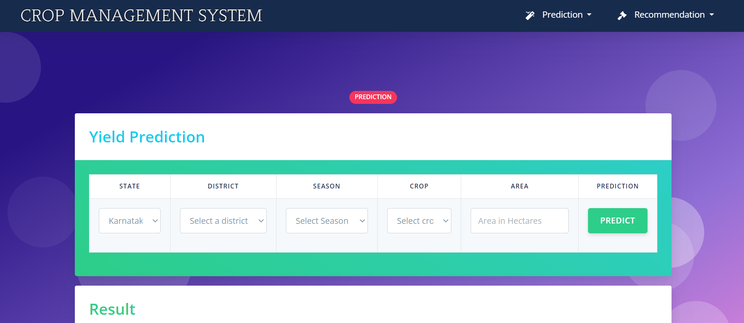
OUTPUT

Slide 16
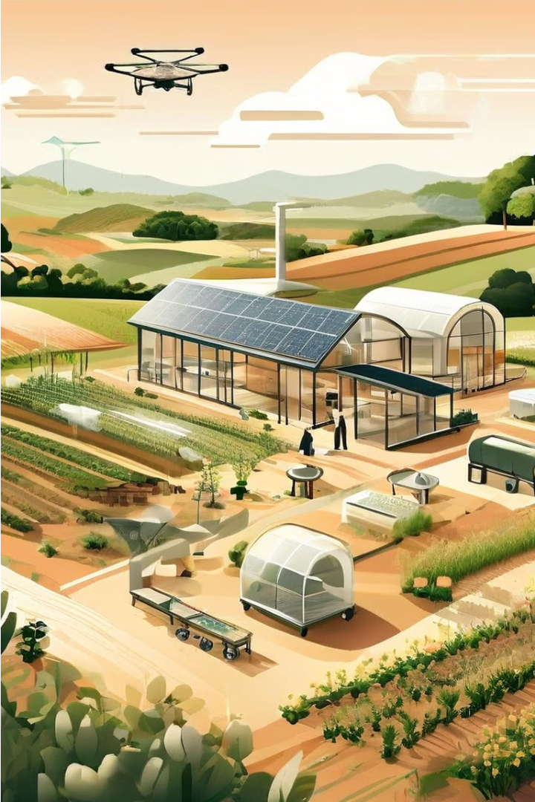
Conclusion and Future Developments
Our comprehensive Agriculture Management System combines cutting-edge technologies and data-driven insights to revolutionize agricultural practices. As we continue to evolve and expand our capabilities, we are committed to empowering farmers and contributing to a more sustainable and prosperous future for the industry.

Slide 17


